Slide 1
Cyber security
By
Raja sekhar K

Slide 2
contents
Definition
Origin of the word
Cybercrime and information security
Who are cyber criminals
Classification of cyber crimes
Legal perspective
Indian prespective
IT ACT 2000
Global prepective
Cybercrime Era

Slide 3
Cyber security
the protection of computer systems from theft or damage to their hardware, software or electronic data, as well as from disruption or misdirection of the services they provide.
Simply using are targeting the modern technologies and computing devices for illegal activities.
Cyber means
collection of the electric and computing devices connected to the internet are addressed by the word cyber.
Cyber security means protecting people from the cyber crimes

Slide 4
Cyber crime and information security
Criminal activities done through or targeting the cyber space is called as cyber crime
Information security is the
practice of preventing unauthorized access, use, disclosure, disruption, modification, inspection, recording or destruction of information.

Slide 5
Who is cyber criminal ?
A cybercriminal is an individual who commits cybercrimes, where he/she makes use of the computer either as a tool or as a target or as both. Cybercriminals use computers in three broad ways:
Select computer as their target: These criminals attack other people's computers to perform malicious activities, such as spreading viruses, data theft, identity theft, etc.
Uses computer as their weapon: They use the computer to carry out "conventional crime", such as spam, fraud, illegal gambling, etc.
Uses computer as their accessory: They use the computer to save stolen or illegal data.

Slide 6
Classification of cyber crimes
Cyber crime against individual
Cyber crime against property
Cyber crime against organization
Cyber crime against society

Slide 7
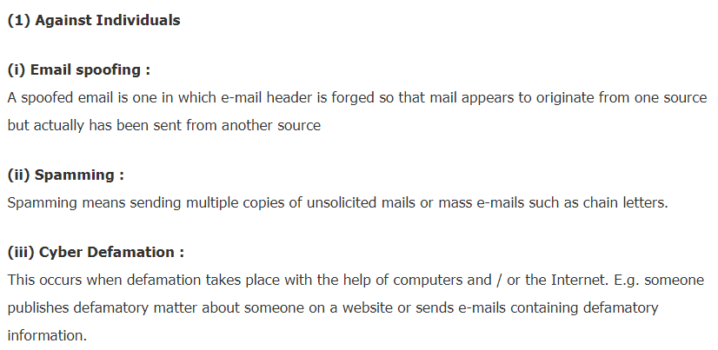
Cyber crime against individual

Slide 8
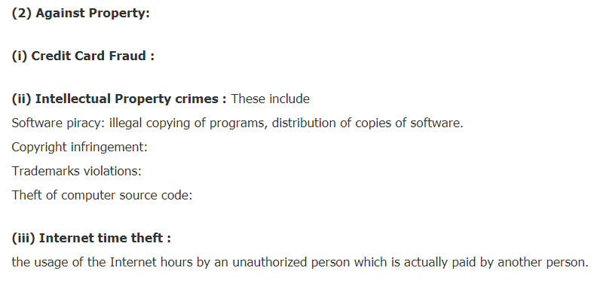

Slide 9
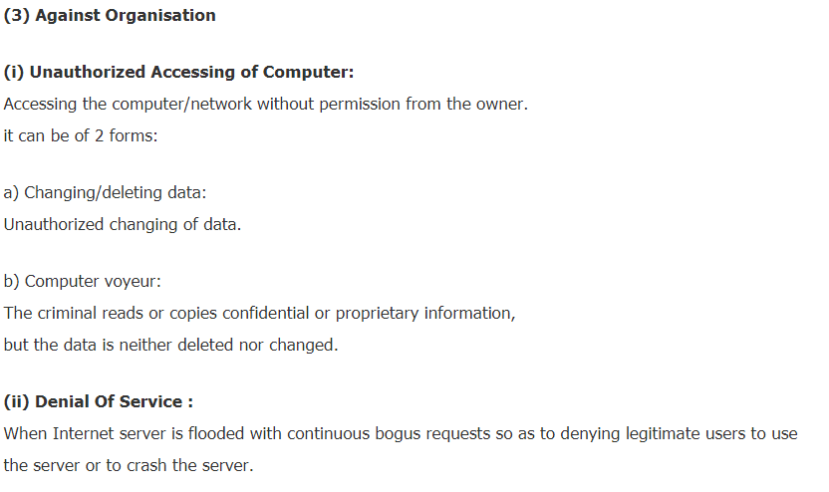

Slide 10
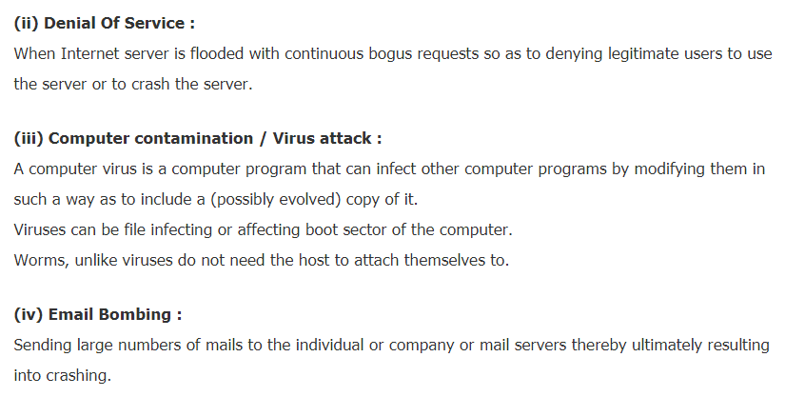

Slide 11
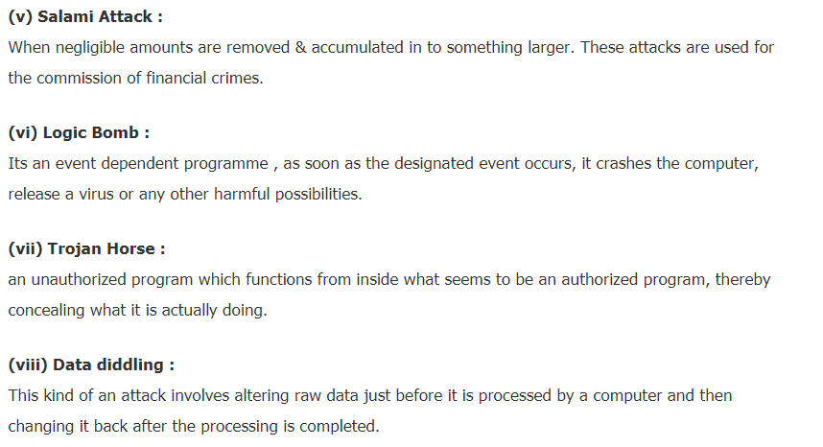

Slide 12
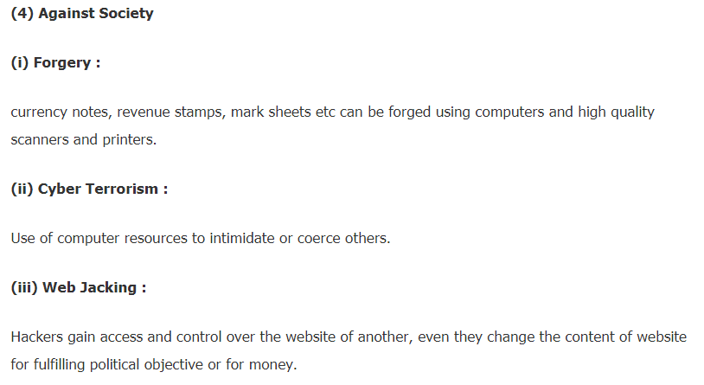

Slide 13
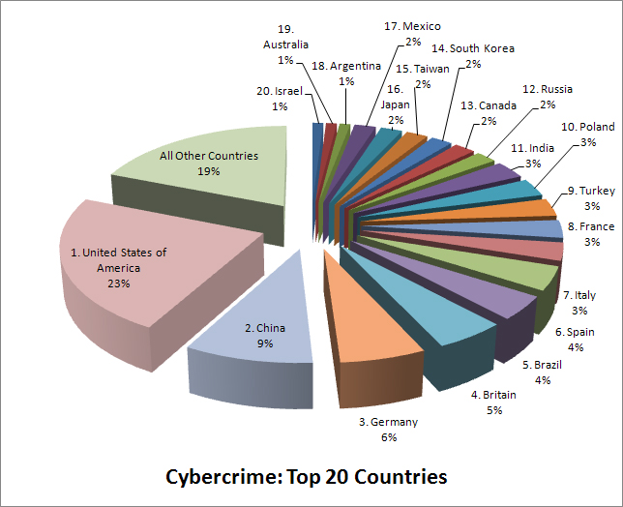

Slide 14
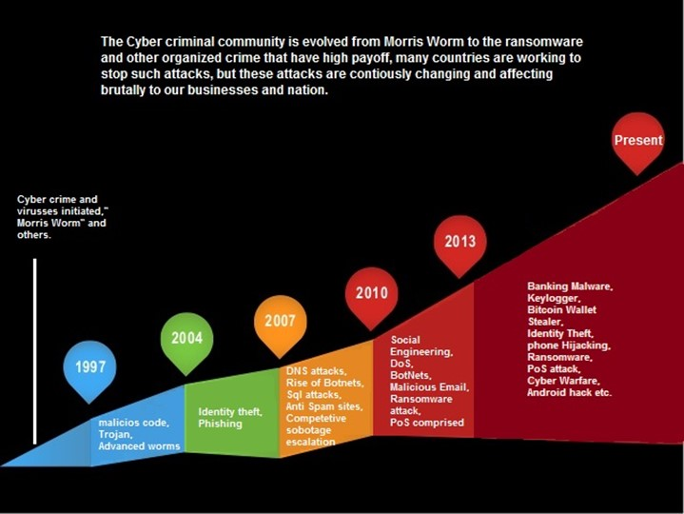
Growth of cyber crimes

Slide 15
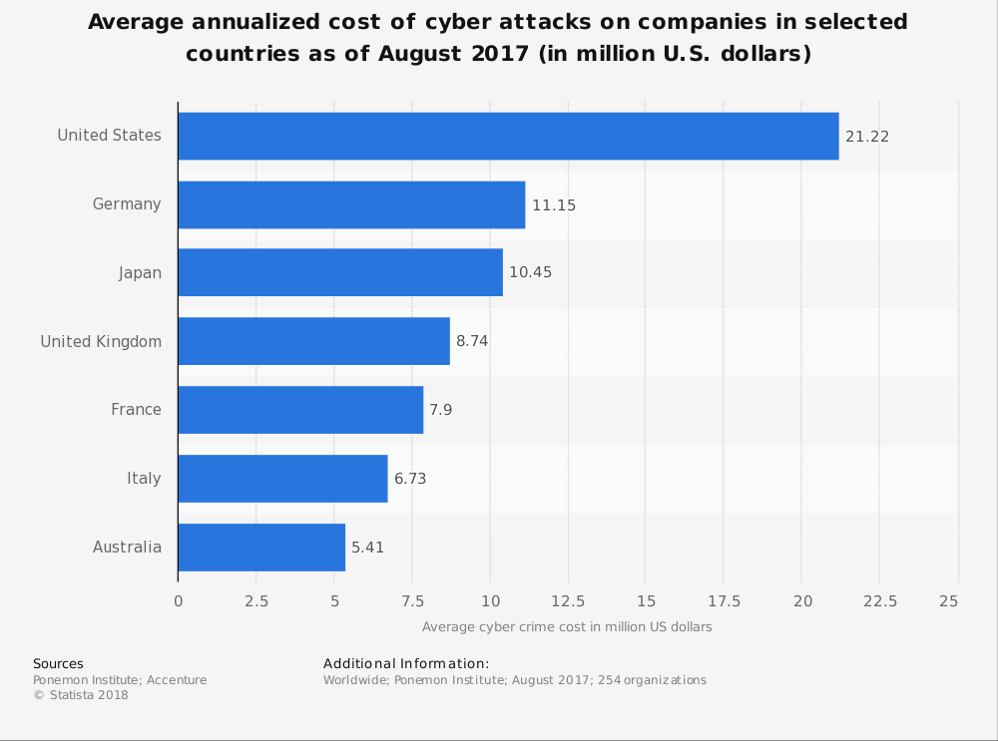
Loss of money by cyber crimes

Slide 16
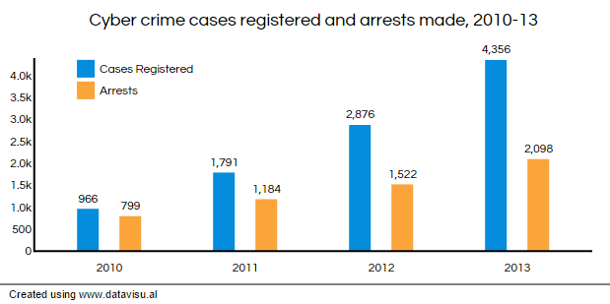

Slide 17
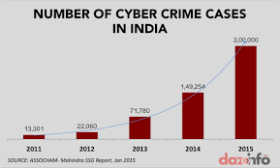
Legal perspective in INDIA

Slide 18
issues with cyber crimes
Lack of cyber skills
Lack of awareness
Organisational silos
Manual silos
Teenage stunts
Data manipulation technologies
Miss use of social websites
Various forms
Easy money

Slide 19
Legal issues with cyber crime

Slide 20

No geographical boundaries

Slide 21
Variations in judiciary of locations
Crimes may happen between countries having different constitutions
Different company policies may involve

Slide 22
New kinds of cyber threats
Viruses
Worms
Trozen horses
Ransomewares

Slide 23
New kinds of cyber threats
Viruses
Worms
Trozen horses
Ransomewares

Slide 24
New strategies of cyber crimes
Phishing
Vishing
Mail spoofing
Webjacking
Spreading fake news

Slide 25

Challenge in catching hacker

Slide 26
Storing of digital data
Network
Internet
Clouds
Mobile devises

